Slide 1
BCOG 100
Mind and Brain Lecture 2:
Levels of Analysis

Slide 2
Starting question
Password: three
Question: What are David Marr’s Three Levels of analysis.
Give a definition of each in your own words.

Slide 3
Mind-Body Solutions
Two Dimensions of Disagreement
Ontological Dependence: Is the mind a different kind of “stuff” than the physical, material world?
Explanatory Separability: Can we understand the physical and the mental independently (whatever they are made of)?
 |  | Ontologically Dependent?
 |  | Yes | No
Explanatorily Separable | Yes | 4 | 1
 | No | 2 | 3

Slide 4
Mind-Body Solutions: Quadrant 4
The Popularity of Quadrant 4:
Still materialist and scientific (as opposed to quadrant 1 and 3)
Psychological explanations work
Theoretical limitations: can you really eliminate all talk of memory, attention, concepts?
Most sciences are reductive without being eliminativist
Practical constraints. modeling in terms of neurons is intractable
Multiple realizability

Slide 5
Mind-Body Solutions: Quadrant 4
 |  | Ontologically Dependent?
 |  | Yes | No
Explanatorily Separable | Yes | 4
 | No
Definition: Mind depends on physical systems, but can sometimes be explained in terms that are not reduced to physical ones.
Example: Functionalism
What makes something a mental state is what it does, not what it’s made of. Pain = the state that’s caused by injury and leads to avoidance, regardless of whether it’s in a brain, a robot, or an alien.
Mental states are defined by their functions or roles in a system, not their physical substance.
Problem: It struggles with qualia — explaining why these functional roles are accompanied by felt experience (“what it’s like” to be in pain).

Slide 6
Mind-Body Solutions: Quadrant 4
 |  | Ontologically Dependent?
 |  | Yes | No
Explanatorily Separable | Yes | 4
 | No
Definition: Mind depends on physical systems, but can sometimes be explained in terms that are not reduced to physical ones.
Example: Emergentism
Mental phenomena emerge from complex physical systems like the brain, the way liquidity emerges from H₂O molecules.
The mind is not separate from the brain, but it has new properties that aren’t reducible to the properties of neurons.
Problem: Critics ask whether “emergence” really explains anything — or if it’s just a label for our ignorance about how brain activity produces cognition.

Slide 7
Mind-Body Solutions: Quadrant 4
 |  | Ontologically Dependent?
 |  | Yes | No
Explanatorily Separable | Yes | 4
 | No
Definition: Mind depends on physical systems, but can sometimes be explained in terms that are not reduced to physical ones.
Example: Multiple Levels of Analysis
To understand the mind, we must explain it at different levels:
Each level gives a valid, necessary kind of explanation; no single level captures the whole picture.
Problem: How do we connect the levels? For example, how do abstract computations (like vision) map onto specific neural processes?

Slide 8
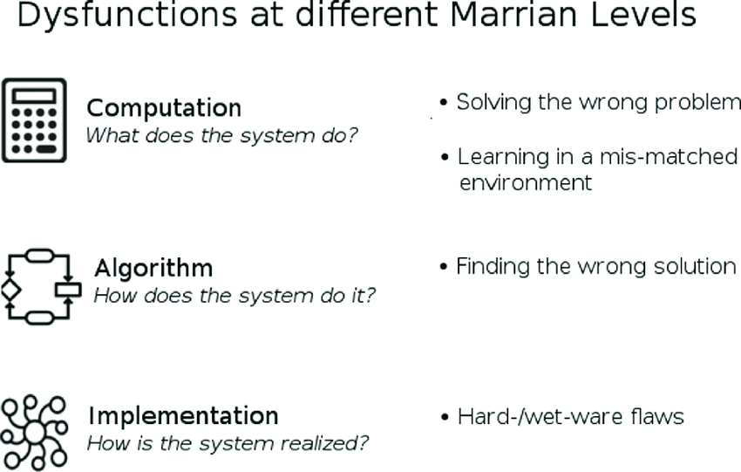
David Marr’s Levels of Analysis
Computational level: What is the system doing? What is the problem being solved?
Algorithmic level: How is it being done? What representations and processes are used?
Implementational level: Where and by what physical means is it carried out?

Slide 9

Example: Vision
Computational level: The goal is to recover 3D structure of the world from 2D retinal images.
Algorithmic level: Edge detection, depth cues, object segmentation, recognition processes.
Implementational level: Retinal cells, LGN pathways, cortical neurons in V1, V2, IT, etc.

Slide 10
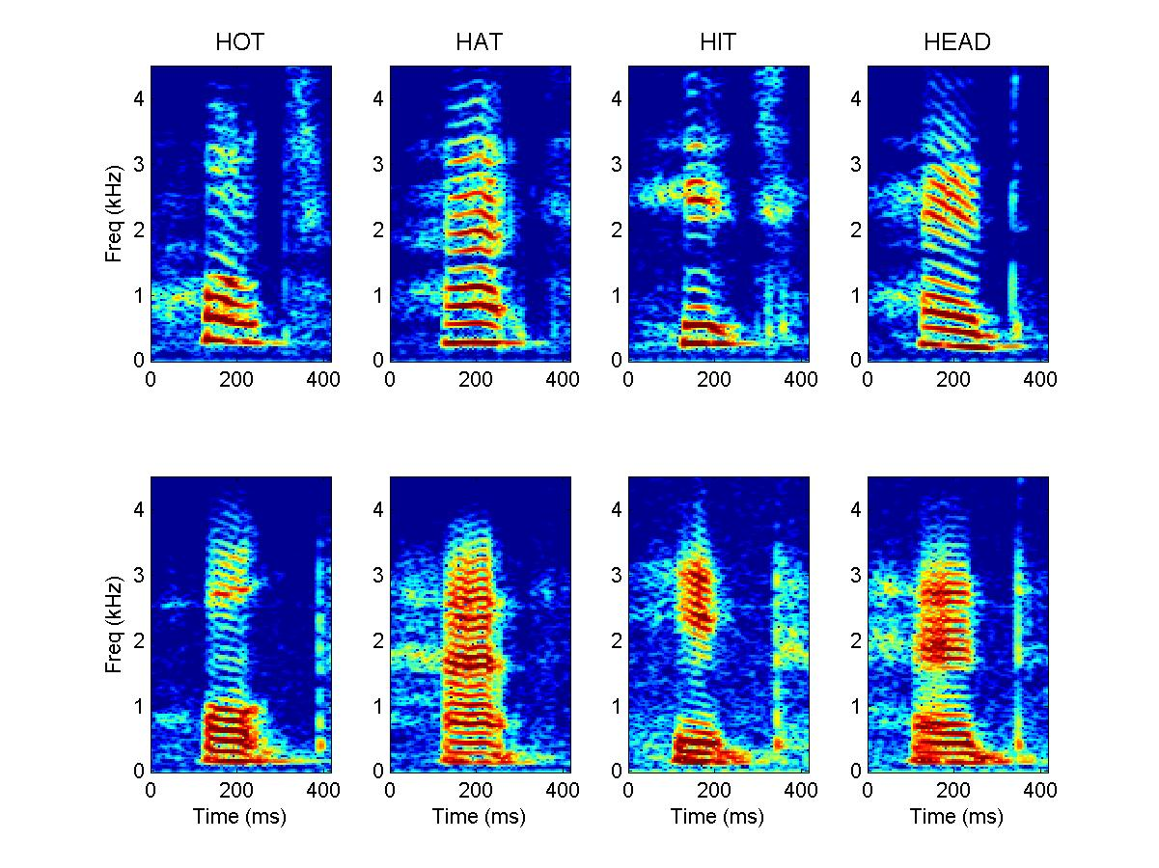
Example: Language
Computational level: Map an acoustic signal onto a speaker’s intended message.
Algorithmic level: Segment words, determine syntactic structure, compute meaning of whole utterance.
Implementational level: Neurons in auditory cortex, temporal lobe, Broca’s area, recurrent neural networks, etc.

Slide 11
Strengths and Benefits of Marr’s Approach
Encourages clarity: distinguish what from how from where.
Supports explanatory separability: cognitive models don’t have to map directly to neurons.
Helps avoid reductionist traps (e.g., dismissing psychology because we have neuroscience).
Provides a division of labor across disciplines (psychology, neuroscience, AI, philosophy).
😀

Slide 12
Challenges to Marr’s Approach
Rigid separation: In practice, levels are not always independent.
Top-down bias: Assumes the computational problem is well-defined in advance.
Real systems are messy: Evolution doesn’t optimize cleanly for abstract “functions.”
Example: modern AI shows implementational details (architecture, data statistics) shape what algorithms emerge.
🤨

Slide 13
Challenges to Marr’s Approach
Marr’s view:
Computational: The goal is to store experiences and retrieve them later.
Algorithmic: Processes like encoding, storage, and retrieval.
Implementational: Brain regions like the hippocampus and cortex.
Problem:
The way memory works depends heavily on the brain’s wiring.
For example: The hippocampus is especially good at quickly linking events together, but struggles with long-term storage on its own.
This means the “algorithm” is shaped by the biology — you can’t neatly separate the levels.

Slide 14
Another Way of Thinking About Levels
There are a lot of different ways you can move your mouth and say “hot”
There are a lot of different auditory vibrations you can detect and hear “hot”
Is speaking or hearing “hot” a “real” thing?

Slide 15
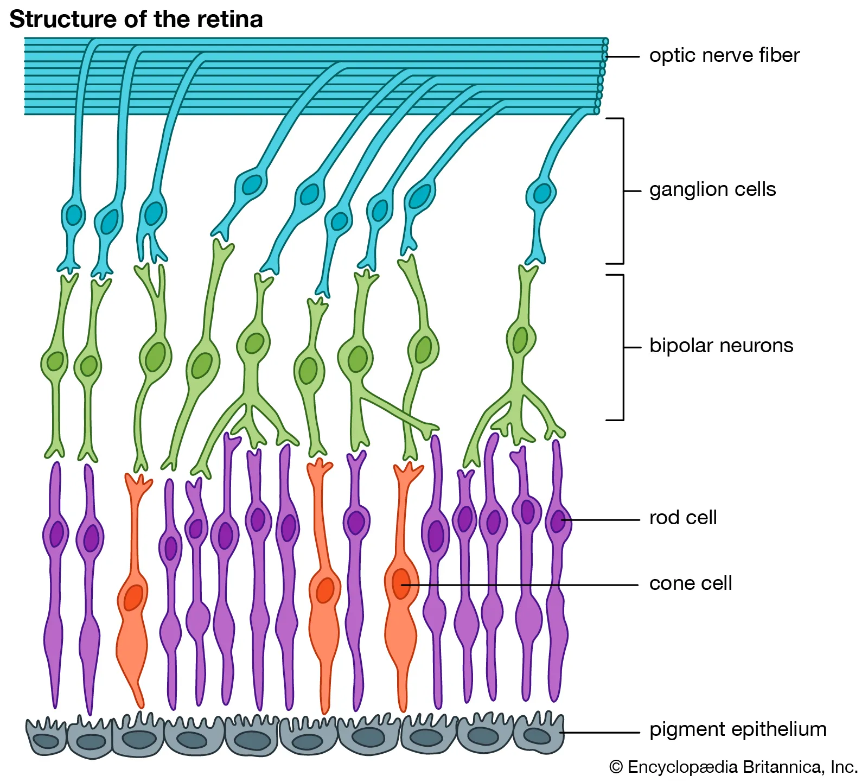
Another Way of Thinking About Levels
Is the concept useful? Does it lead to predicting things as well, with less complexity?

Slide 16
Another Way of Thinking About Levels
Time since last water intake
Water Consumed
Persistence in Obtaining Water
Salt intake
Fluid loss
Salivation

Slide 17
Another Way of Thinking About Levels
Time since last water intake
Water Consumed
Thirst
Persistence in Obtaining Water
Salt intake
Fluid loss
Salivation
Is the concept useful? Does it lead to predicting things as well, with less complexity?

Slide 18
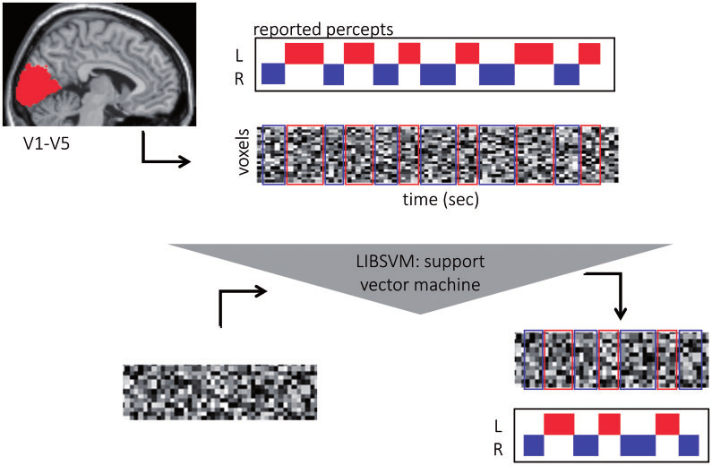
Another Way of Thinking About Levels
BLUE
“blue”
Is the concept useful? Does it lead to predicting things as well, with less complexity?

Slide 19
Another Way of Thinking About Levels
D
A
B
C

Slide 20
Summary
Marr’s levels remain hugely influential.
Most cognitive sciences endorse multi-level explanations.
But modern work highlights interactions between levels: not cleanly separable, often mutually constraining.
Most scientists are not dogmatic about what the levels are. The focus is more pragmatic.
Do your concepts make good predictions
Do they help lead to understanding

